Slide 1
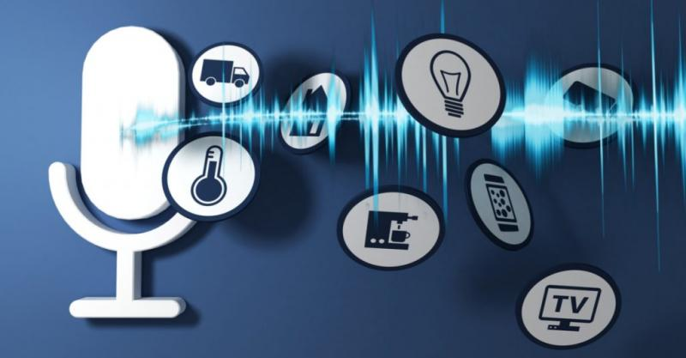
Speech Emotional Recognition

Slide 2
Sohayb Wael
Ahmed Adel
Mustafa Ryad

Slide 3
When you’re running a business with limited staff and/or resources, keeping productivity and efficiency at all-time highs are top priorities. By using speech recognition to convert audio and video into perfectly-accurate text
Introduction :

Slide 4
Hearing & Understanding Customers :
Your customers’ opinion of your company and brand mean absolutely everything, and so it’s critical to truly understand them. Our speech recognition makes it possible to better interpret what your customers actually feel about your product, service or business as a whole, by performing in-depth data mining on recorded calls. After all, a more realistic view of your customers can provide a greater picture of the health of your organization.

Slide 5
StreamLine The Support Process :
Your recorded audio from customer calls may just hold the answer to a better way to provide support. After taking the time to capture customer interactions and then analyzing the findings, you’ll be able to pinpoint the issues that people need the most help with to make the customer support process much more optimized.

Slide 6
Identify Callers & mitiGate Risk :
Who is really calling your business? With speech recognition solutions that capture audio using best-in-class voice biometrics, your organization can easily identify and authenticate each caller in order to better detect and mitigate fraud. Our voice biometrics are available for both active and passive voice-print capture and is currently used by financial institutions and government agencies around the world .

Slide 7
Monitors Support Agents & Representatives :
When your customers and clients have an important question, they’ll be sure to call it in. As agents field these calls, it’s absolutely necessary that they are conveying the proper information in an approachable, brand-friendly way. By taking advantage of speech recognition to capture and analyze audio, you can easily track each customer-agent communication to better understand and monitor your representatives on the front lines.

Slide 8
THANK YOU

